Slide 1
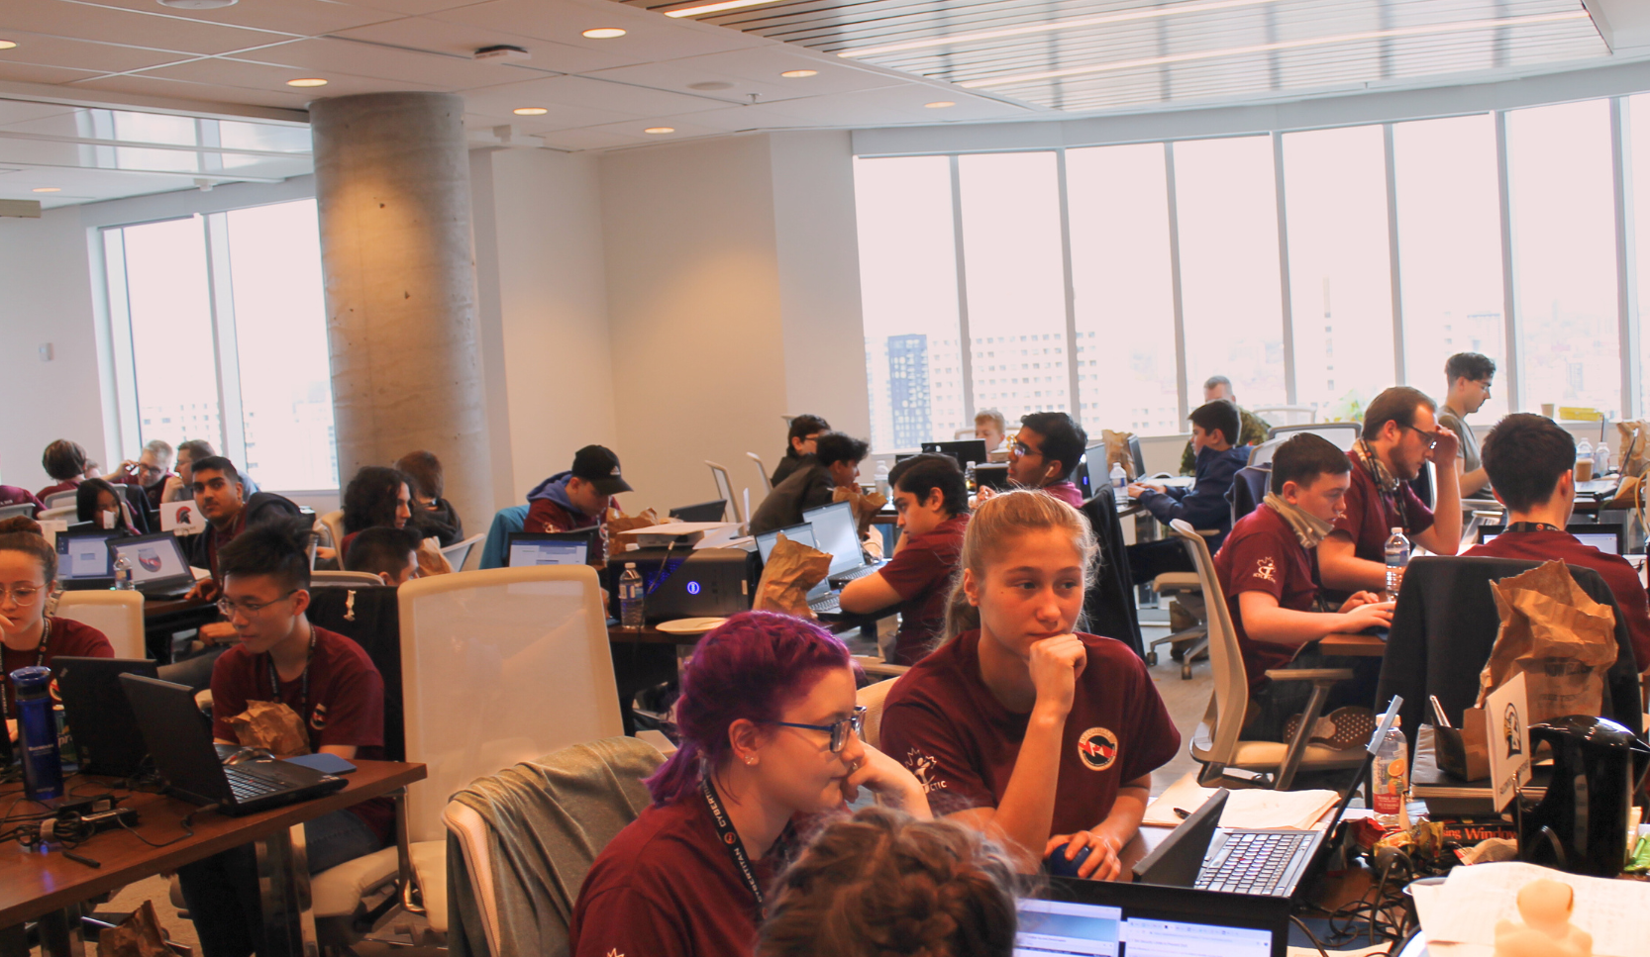


ICTC CyberTitan
Canada’s Largest Student Cybersecurity Competition

Slide 2



Empowering the Next Generation of Cyber Defenders
CyberTitan is Canada's largest and longest-running cybersecurity competition for middle and high school students. Organized by the Information and Communications Technology Council (ICTC), it runs in schools across Canada and is celebrated by an annual national competition to crown Canada’s top student cybersecurity team.
This engaging, skills-focused program provides students with hands-on learning experience by simulating real-world cybersecurity challenges with the same technology cybersecurity professionals use. CyberTitan alumni have outstanding problem-solving, teamwork, and technical skills that set them on a path toward becoming Canada’s next generation of cybersecurity professionals, innovators, and digital leaders.

Slide 3
Competition Timeline (2024-2025)
Preliminary Competitions
Semi - Finals
CyberTitan Finals
Team Registration Opens
Team Registration Closes
High School Round 1
High School Round 2
High School Round 3
APR 1
OCT 3
OCT 24 - 27
NOV 14 - 17
DEC 12 - 15
JAN 23 - 25
May 2025
Middle School
Round 1
Middle School
Round 2

Slide 4
CyberTitan Sponsorship Opportunities
6000+ STUDENTS
GRADES 5 TO 12
Why Sponsor CyberTitan?
Over 6,000 students from across Canada have participated since CyberTitan launched in 2017.
Middle school, high school, and Cadets Canada competitions are held throughout the country leading up to the national finals.
Build your brand among thousands of students, educators, and cybersecurity professionals across Canada, and achieve national and regional press coverage.
Demonstrate that you are:
  Developing future talent by investing in the next generation of cybersecurity professionals.
  Solving the growing cybersecurity skills gap by building a pipeline of future talent.
  Committed to opening possibilities for youth by providing learning experiences that set them up for success in their future careers.
  Affiliated with Canada’s leading cybersecurity organizations. Connect with government and industry leaders and Canada’s top cyber research centres.
109 ALL-GIRLS TEAMS
REAL-WORLD CYBERSECURITY THREATS
Since CyberTitan was launched, 109 all-girls teams have joined the competition to encourage gender diversity in cybersecurity. The top all-girls team earns a wildcard spot at the national finals.
Competitions emulate actual cybersecurity threats faced by Canadian businesses.

Slide 5
Benefits | Title Partner ($400,000) | Regional Semi-Finals Partner ($150,000) | Platinum Partner ($75,000) | Gold Partner ($50,000) | Silver Partner ($25,000)
Number Available | 1 | 3 | 3 | 2 | Unlimited
Collateral Benefits
Brand Exclusivity: Your brand logo is prominently displayed as "Presenting Partner" on all CyberTitan materials, event banners, and digital assets.
Primary logo and name placement on CyberTitan landing page
Sole partner placement on CyberTitan tradeshow banners
Logo placement on all printed and digital collateral
Exclusive press release, newsletter and media feature announcing the partnership
Full-year brand recognition for CyberTitan
Included in all press releases and media mentions secured by ICTC
Monthly social media recognition
Premium placement on CyberTitan t-shirt
Placement on CyberTitan t-shirts
Event Benefits
Keynote speaker at CyberTitan National Finals
Invitation to (closed) CyberTitan National Competition
Invitation to CyberTitan Awards Ceremony
Student Swag Opportunity: Option to provide branded items for event swag bags distributed to participants.
VIP Access to future CyberTitan events for the following year
Company Banner at National Finals
Participate in CyberTitan National Finals scenario planning
Panel participation at the CyberTitan National Finals
Targeted Student Engagement: Opportunity to host workshops or webinars tailored to regional participants.
Nominate a media spokesperson from your organization to engage with regional media opportunities
Present awards to CyberTitan champions
Awards ceremony recognition

Slide 6
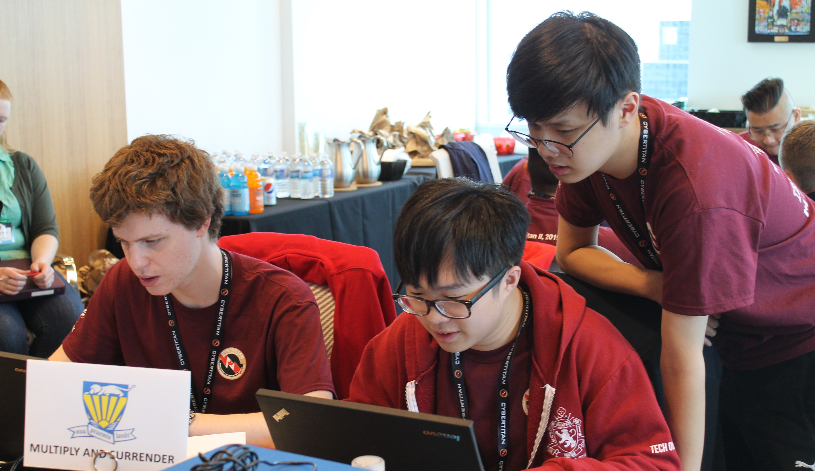
Join us in Shaping Canada's Digital Future
By sponsoring CyberTitan, you're not just supporting a competition – you're investing in Canada's digital future. Help us inspire and educate the next generation of cyber defenders while positioning your organization at the forefront of this critical field.

Slide 7
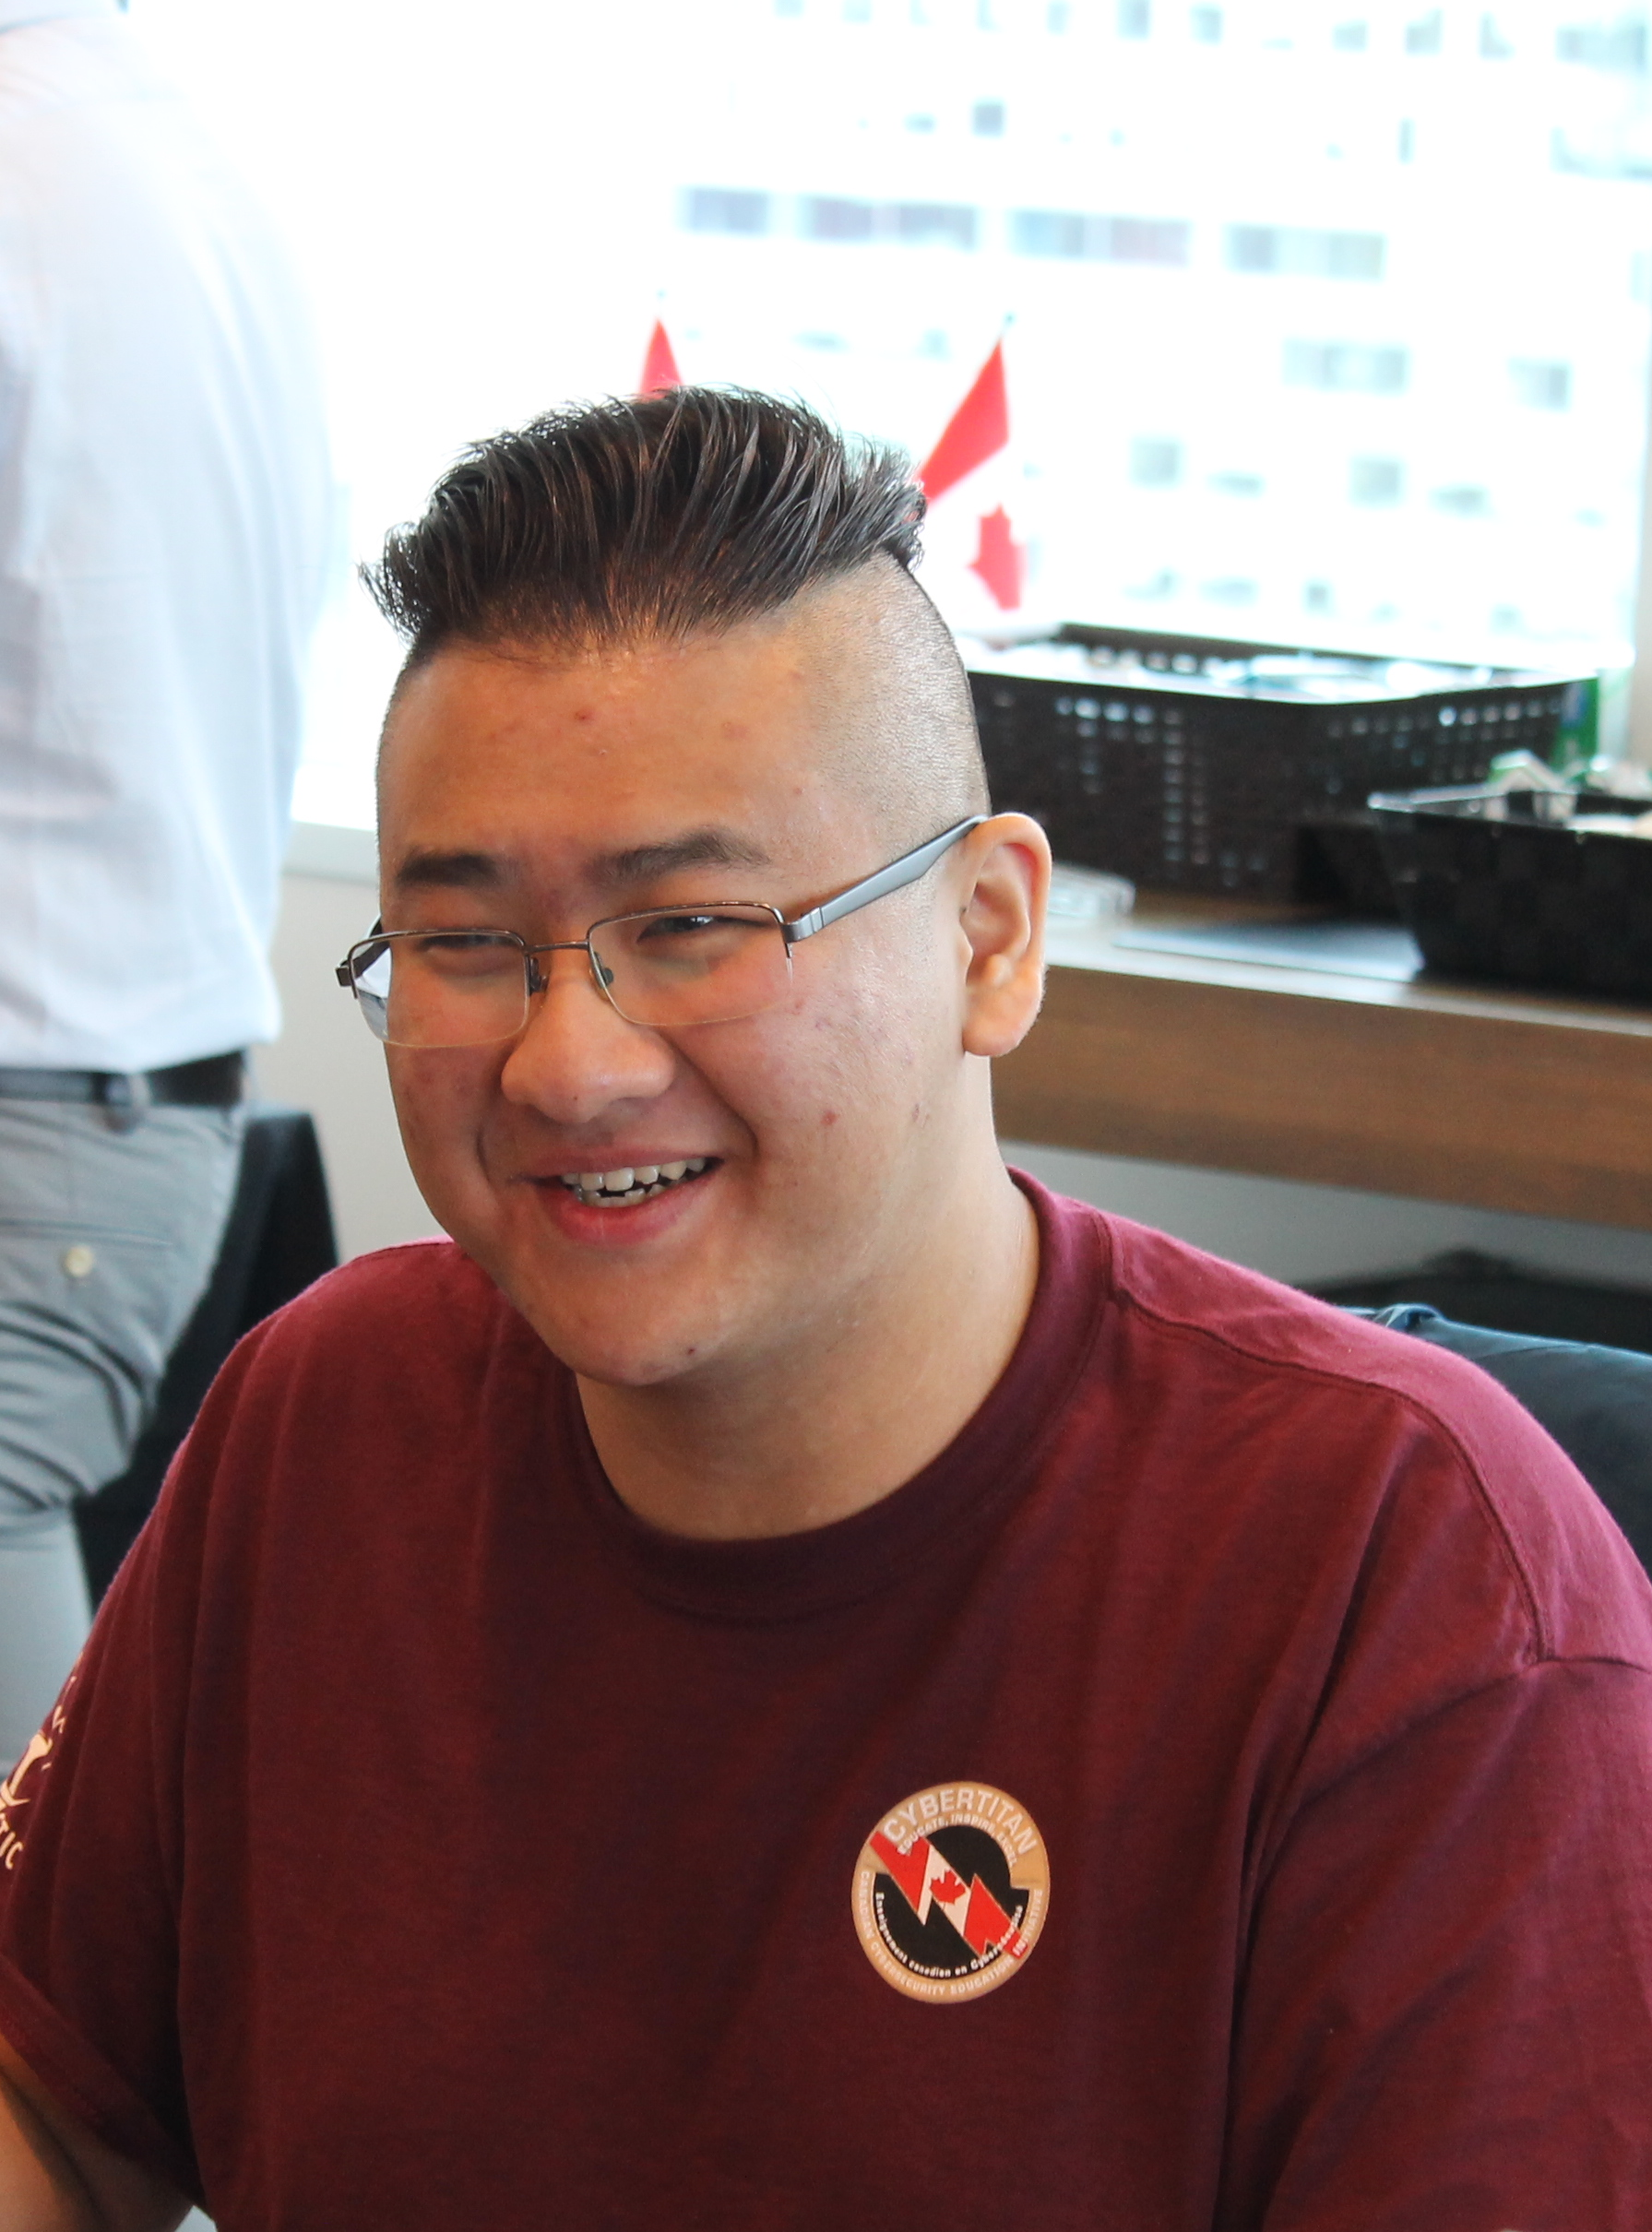
About the Information and Communications Technology Council (ICTC)
The Information and Communications Technology Council (ICTC) is a neutral, not-for-profit national centre of expertise with the mission of strengthening Canada's digital advantage in the global economy.
For over 30 years, and with a team of 100 experts, we have delivered forward-looking research, practical policy advice, and capacity building solutions for individuals and businesses. Our goal is to ensure that technology is utilized to drive economic growth and innovation and that Canada's workforce remains competitive on a global scale.
Contact:
Sheena Bolton (She/Her)
Manager: K-12, CyberTitan and Cyber Education Initiatives | Gestionnaire, maternelle à la 12e année, CyberTitan et initiatives de cyberéducation
Tel: 613-237-8551 ext. 154

